Slide 1
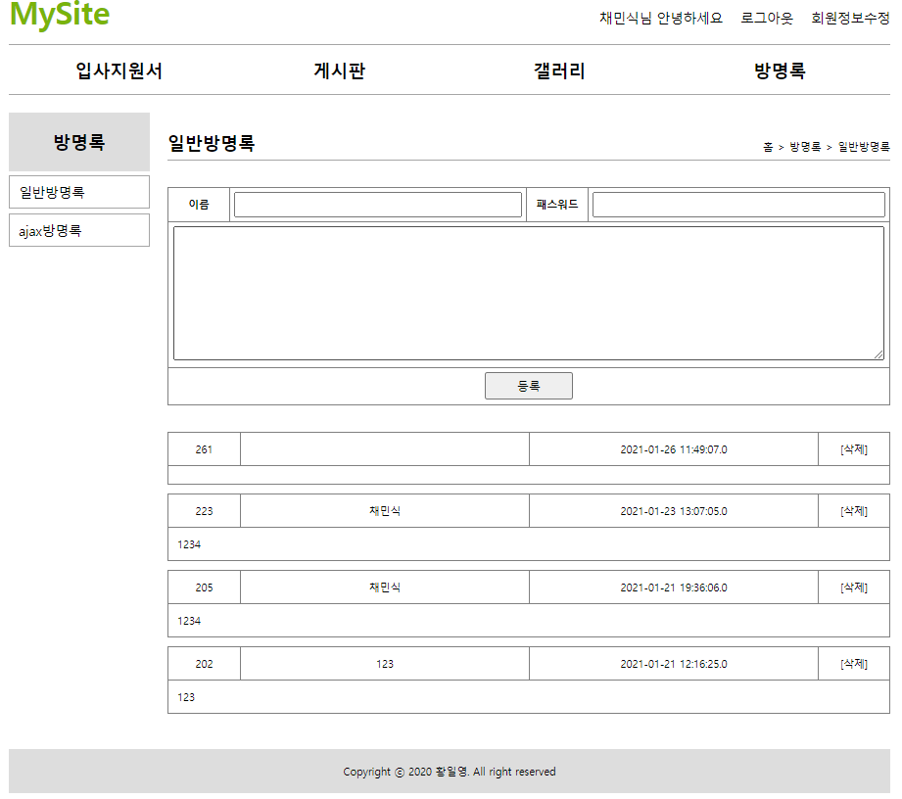
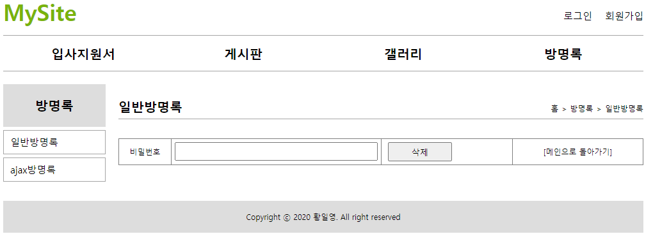

■mysite5 - guestbook
사용자
jsp
controller
service
dao
sqlSession
xml
리스트화면
List<GuestbookVo>
sqlSession.selectList
(”guestbook.selectList”)
http://localhost:8088/mysite5/guestbook/addList
List<GuestbookVo>
List<GuestbookVo>
id=”selectList”
/guestbook/addList
resultMap=”resultMapGuesbookVo
@ModelAttribute
GuestbookVo{
no=?
name=?
password=?
content=?
sysdate=?
}
등록
GuestbookVo
GuestbookVo
GuestbookVo
parameterType=”com.javaex.vo.GuesbookVo”
http://localhost:8088/mysite5/guestbook/add
insert(guestbookVo)
insert(guestbookVo)
insert(guestbookVo)
sqlSession.insert
(”guestbook.insert”, guestbookVo)
id=”insert”
/guestbook/add
insert(guestbookVo)
count
count
성공갯수
삭제폼
http://localhost:8088/mysite5/guestbook/deleteForm?no=${gbVo.no}
deleteForm
deleteForm.jsp
return ”/guestbook/deleteForm”
@ModelAttribute
GuestbookVo{
no = ?
password=?
}
삭제
GuestbookVo
GuestbookVo
GuestbookVo
parameterType=”com.javaex.vo.GuesbookVo”
http://localhost:8088/mysite5/guestbook/delete
delete(GuestbookVo)
delete(guestbookVo)
delete(guestbookVo)
sqlSession.delete
(”guestbook.delete”, guestbookVo)
id=delete”
/guestbook/addList
ex == 1 (삭제성공)
count
count
성공갯수
redirect:/guestbook/passwordcheck
ex == 0 (삭제실패)
guestbook/addList
deleteForm.jsp

